Slide 1
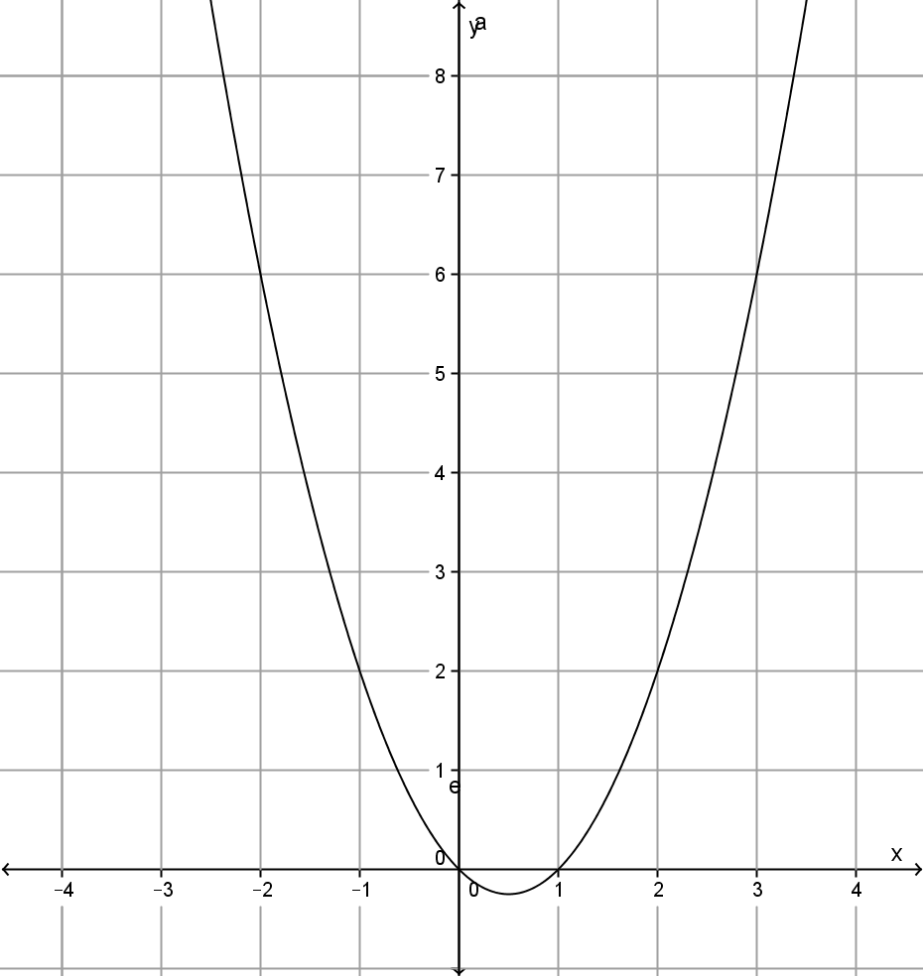
My Non-linear Relationship Interactive Notebook
Name
Class
Mrs Rust
Term 4 Semester 2
1

Slide 2
Create your own front page
It needs to contain the following –
My Non-Linear Relationships interactive notebook
Name
Class
Teachers Name
Semester 2 Term 4
Page number 1

Slide 3
Contents
Glossary or Formula Page
Page
Date
Description
2
3

Slide 4
Tasks
24
7
30
Essential Question
Questions
Notes
Summary
4
5

Slide 5
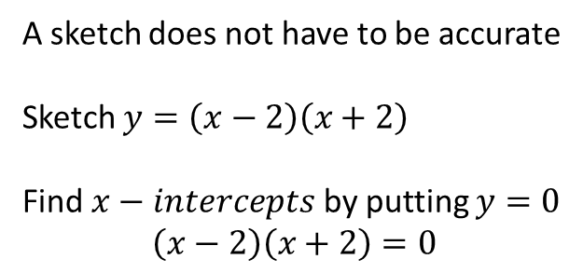
24
7
30
Date
Sketching quadratic relations
EQ – Describe how to sketch a quadratic relationship.
A sketch does not have to be accurate
Sketch $y=\left(x−2\right)\left(x+2\right)$
Find $x−intercepts$ by putting $y=0$
$$\left(x−2\right)\left(x+2\right)=0$$
9

Slide 6
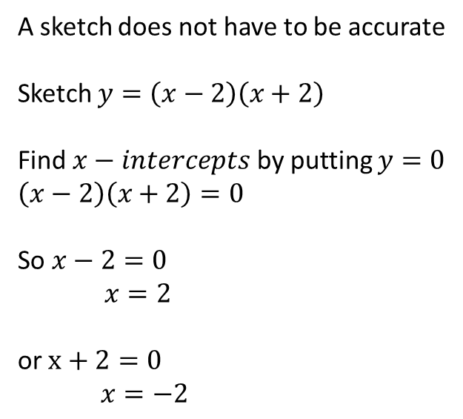
24
7
30
Date
Sketching quadratic relations
EQ – Describe how to sketch a quadratic relationship.
A sketch does not have to be accurate
Sketch $y=\left(x−2\right)\left(x+2\right)$
Find $x−intercepts$ by putting $y=0$
$$\left(x−2\right)\left(x+2\right)=0$$
So $x−2=0$ $$x=2$$
or $x+2=0$
$x=−2$
9

Slide 7
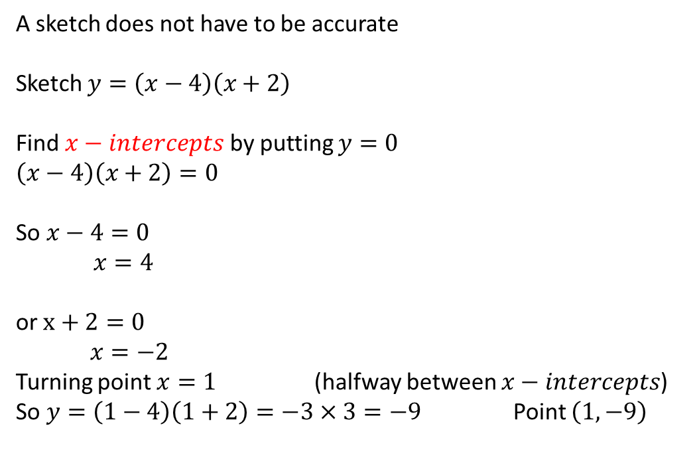
24
7
30
Date
Sketching quadratic relations
EQ – Describe how to sketch a quadratic relationship.
A sketch does not have to be accurate
Sketch $y=\left(x−4\right)\left(x+2\right)$
Find $x−intercepts$ by putting $y=0$
$$\left(x−4\right)\left(x+2\right)=0$$
So $x−4=0$ $$x=4$$
or $x+2=0$
$x=−2$
Turning point $x=1$ (halfway between $x−intercepts$)
So $y=\left(1−4\right)\left(1+2\right)=−3×3=−9$ Point $\left(1,−9\right)$
9

Slide 8
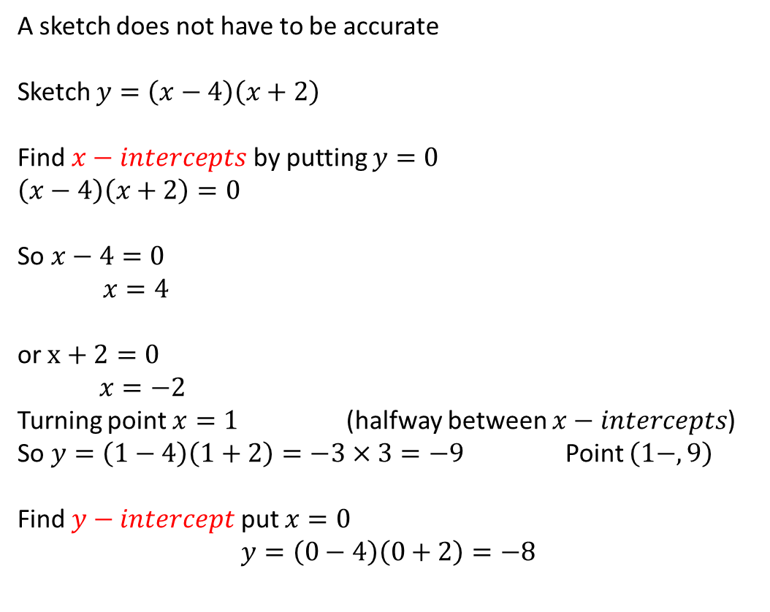
24
7
30
Date
Sketching quadratic relations
EQ – Describe how to sketch a quadratic relationship.
A sketch does not have to be accurate
Sketch $y=\left(x−4\right)\left(x+2\right)$
Find $x−intercepts$ by putting $y=0$
$$\left(x−4\right)\left(x+2\right)=0$$
So $x−4=0$ $$x=4$$
or $x+2=0$
$x=−2$
Turning point $x=1$ (halfway between $x−intercepts$)
So $y=\left(1−4\right)\left(1+2\right)=−3×3=−9$ Point $\left(1−,9\right)$
Find $y−intercept$ put $x=0$
$$y=\left(0−4\right)\left(0+2\right)=−8$$
9

Slide 9
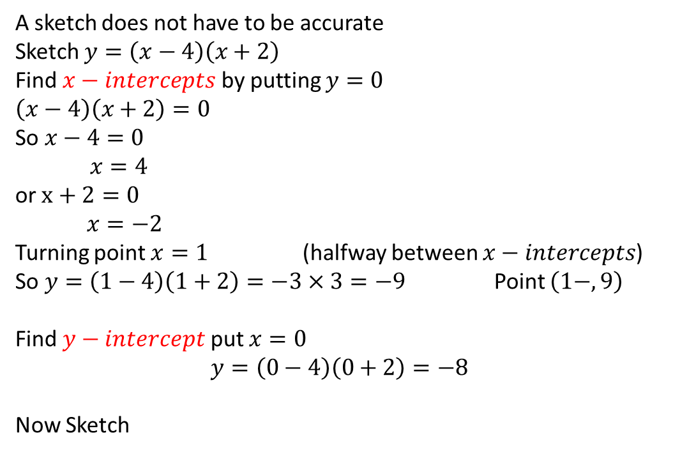
24
7
30
Date
Sketching quadratic relations
EQ – Describe how to sketch a quadratic relationship.
A sketch does not have to be accurate
Sketch $y=\left(x−4\right)\left(x+2\right)$
Find $x−intercepts$ by putting $y=0$
$$\left(x−4\right)\left(x+2\right)=0$$
So $x−4=0$ $$x=4$$
or $x+2=0$
$x=−2$
Turning point $x=1$ (halfway between $x−intercepts$)
So $y=\left(1−4\right)\left(1+2\right)=−3×3=−9$ Point $\left(1−,9\right)$
Find $y−intercept$ put $x=0$
$$y=\left(0−4\right)\left(0+2\right)=−8$$
Now Sketch
9

Slide 11
Notes Review
24, 7 ,30
Date
Title
Essential question
Notes complete
Notes complete with colour and diagrams
Questions completed
Contents page filed in
Formula page filled in

Slide 12
Homework
Review your notes and write a summary answering the essential question.

